Slide 1
Why We Meditate: The Science And Practice of Clarity and Compassion
CH 1: WHAT THIS BOOK OFFERS YOU

Slide 2
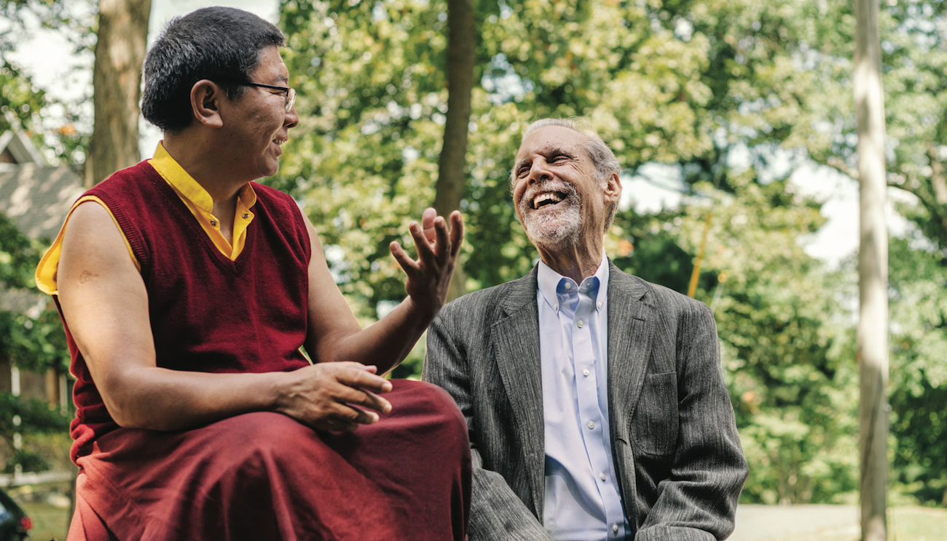

Slide 3
Who is Tsoknyi Rinpoche?
Tsoknyi Rinpoche is a Tibetan Buddhist teacher and the spiritual head of the Pundarika Foundation. He was born in 1966 in Nubri, Nepal, and is a renowned meditation master and author. Tsoknyi Rinpoche is part of the Nyingma school of Tibetan Buddhism, which is one of the oldest schools of Tibetan Buddhism.
Tsoknyi Rinpoche comes from a long line of meditation masters, and he received extensive training in both the Kagyu and Nyingma traditions. He is known for his accessible and humorous teaching style, making ancient Buddhist wisdom relevant and applicable to contemporary audiences.

Slide 4
Who is Daniel Goleman?
Daniel Goleman is an American psychologist and science journalist best known for his work on emotional intelligence. He was born on March 7, 1946, in Stockton, California. Goleman earned his Ph.D. in psychology from Harvard University.
He gained widespread recognition with the publication of his book "Emotional Intelligence: Why It Can Matter More Than IQ" in 1995. In this influential book, Goleman explores the concept of emotional intelligence and argues that it is a crucial factor in personal and professional success. He contends that emotional intelligence, which includes skills like self-awareness, self-regulation, empathy, and interpersonal skills, plays a significant role in determining a person's effectiveness in various aspects of life.
Apart from his work on emotional intelligence, Goleman has written extensively on topics related to psychology, education, and leadership. Some of his other notable books include "Social Intelligence," "Working with Emotional Intelligence," and "Focus: The Hidden Driver of Excellence."

Slide 5
This book is for you:
(1) if you have been considering starting meditation and are not sure why you should or how to begin;
(2) if you are meditating but wonder why or what to do next to progress;
(3) or if you already are a convinced meditator and want to help someone you care about get going, by giving them this book.

